Slide 1
Healthy Blaenavon
Be a Good Neighbour, be a Wellbeing Friend

Slide 2
Local Stories
My husband suffered a stroke a few years ago and was in RGH for 2 weeks. Gareth Davies, Bedelia Dando, Maria Huish- Blount, Edi Aldaya and Laura Bray each offered, unbidden, to take me to the hospital to visit Gary. Their selfless, kind, and compassionate help meant I was able to visit him every day after work and on weekends. Laura looked after our 12-year-old son, John Eli for the first several days when Gary was in resus and the HDU and Edi provided lifts to the Heath for the various follow-up appointments. I will be forever grateful for the support we received from our community and these extraordinarily special people. (Pattie Jenkins)
Last November our beloved family pet chihuahua, Toto, was savaged and killed by another neighbours’ dog. My next-door neighbours Caal and Claire-Louise Mattravers and were incredible. Claire-Louise was with him as he died, she called me and stayed with me until Lyndsey Harris came. Lyndsey rang the vets and sorted everything out as I was too distressed to function. The following week Caal sorted out a new gate, Matt Meredith made and fitted it, as the other had been ripped apart by the dogs getting into my garden. These people will never realise how grateful we are as a family. All of these acts were done with no hesitation, but with kindness and support #bestneighboursever (Emma Harvey)

Slide 3
Local Stories
Anita is a perfect example of a Wellbeing friend and good neighbour. She likes to go to lots of activities in town and knows that some other people her age aren’t online and don’t want to be. When cinema club first began she used to call the Healthy Blaenavon Officer and book her friends on, sometimes there were 10 or more!
From the start of lockdown Deni Harvey made and sold rainbows and masks, we collecting a whopping £162.35. Her plan was to donate half of this to the Arthur Jenkins care home, but instead she had decided she wanted to buy a 'real' baby doll for the residents to love and care for. So, she did just that and had enough to buy the 'baby' a shawl too. Deni, who was 9 at the time also helped her Mum Emma Harvey, shop for food, pay bills and check in on neighbours and deliver prescriptions. She was our youngest “Street Ambassador” during the pandemic.
Two neighbours have supported A since her husband died and will give her lifts to bus stops when she is going on trips with senior citizens, and she rings them when she gets back, and they pick her up too. They take her to Abergavenny if she wants to go there, and one sat with A when she was ill and was waiting for an ambulance

Slide 4
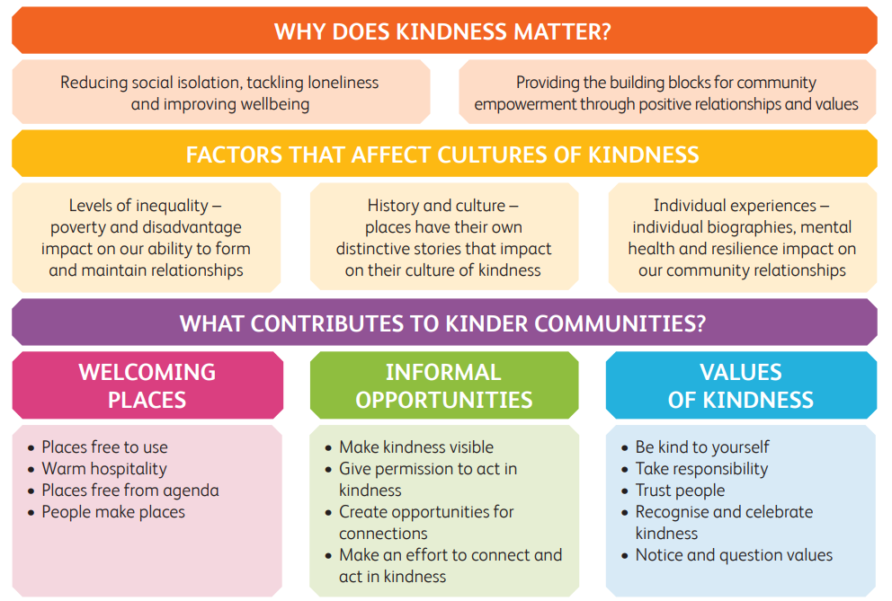
The Place of Kindness (JRF & Carnegie Trust UK)
Notes:
The Place of Kindness: Combating loneliness and building stronger communities - Carnegie UK Trust

Slide 5
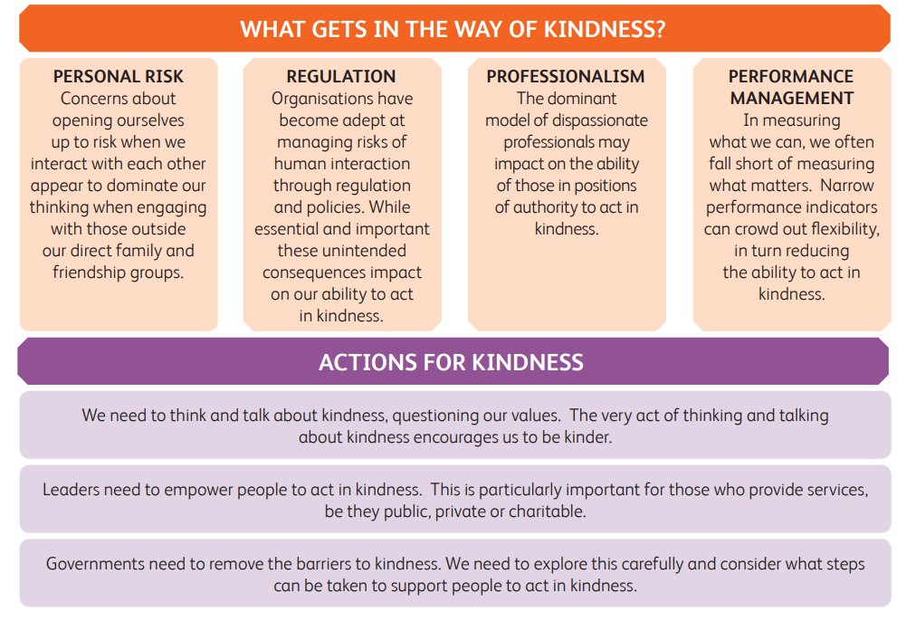
The Place of Kindness (JRF & Carnegie Trust UK)

Slide 6
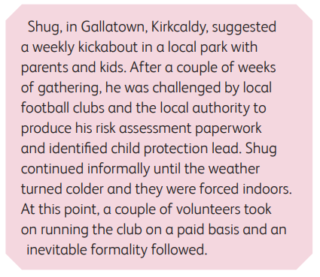
It’s not all about volunteering
But our formalities can deter civic action

Slide 7
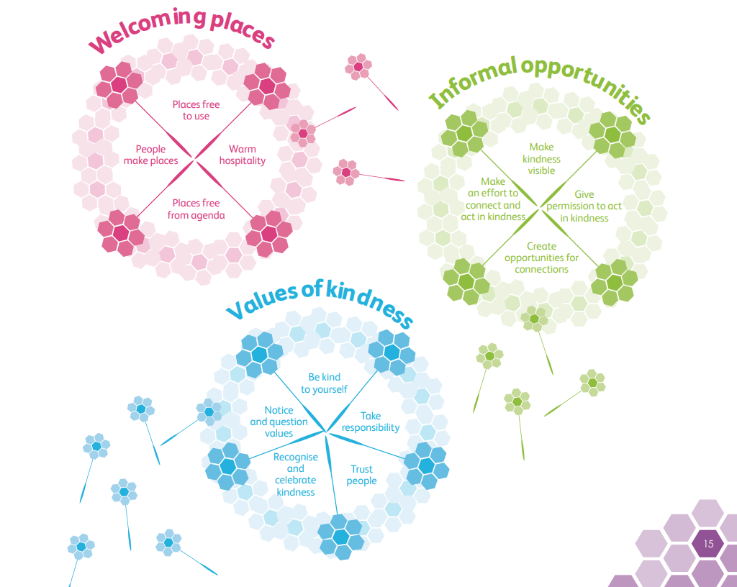
How can we encourage kindness? Discuss

Slide 8
Community Champions / Wellbeing Friends: a starting point?
The National Institute for Health and Clinical Effectiveness (NICE)13 defines health champions as:
“…individuals who possess the experience, enthusiasm and skills to encourage and support other individuals and communities to engage in health promotion activities. They also ensure that the health issues facing communities remain high on the agenda of organisations that can effect change. Health champions offer local authorities and community partnerships short-term support as consultants, encourage them to share good practice and help them develop activities to improve the health of local people.”

Slide 9
Community champions build social capital
“It is important to recognise, as highlighted in the Marmot Review, that health in the most disadvantaged communities will only improve if socio-economic determinants are addressed.
However, community health champions have the potential to be instrumental in creating a cultural shift in communities towards healthier and more integrated living. These findings chime with current discussion around the need to build a society where people take a more active part and engage more with service development and delivery”
Improving health and well-being through community health champions: a thematic evaluation of a programme in Yorkshire and Humber (sagepub.com)

Slide 10
Evidence for building social capital
“4 x more likely to find work through friends than through Job Centre”
Labour Market Participation : The Influence of Social Capital - International Labour Organization (ilo.org)
“Stronger neighbourhoods have significantly less crime”
When disaster strikes, it's survival of the sociable | New Scientist
“Across the whole of Somerset emergency hospital admissions rose by 29% during the three years of the study. In Frome (the site of the project to combat isolation) they fell by 17%”
The town that’s found a potent cure for illness – community | George Monbiot | The Guardian
“Living in a supportive community increases our chance of good health by 27%”
A meta-analysis of social capital and health: a case for needed research - PubMed (nih.gov)

Slide 11
Commitments: What will we do?
The IWN Programme Team will review the Wellbeing Friends initiative across Gwent, explore the evidence base and develop some key principles for the model.
Blaenavon will need local facilitation of this, but the IWN Community Involvement Officer can support with establishing a scheme or an initiative to promote kindness across the community
What will other partners do?

Slide 12
How will we measure success?

